Slide 1
Haiti Money Remittance Location Analysis

Slide 2

Background and problem statement
Haiti is a Caribbean country, historically poor and politically unstable. The CIA World Factbook also states that "remittances are the primary source of foreign exchange…”.
Based on this fact, it’s important to identify areas of opportunity to open Money Remittance locations in strategic areas that can comply with the demand for this type of service

Slide 3

Data acquisition
Data of current locations obtained from one of the remittance company providers (private source) which will be used to understand which areas already have money remittance locations nearby.
Foursquare API to obtain information on venues for the different Haiti departments for the analysis of possible locations opportunities.
Wikipedia to obtain data of population per city and department which will help to analyze areas of opportunity.
Google maps to obtain precise latitude and longitude coordinates.

Slide 4
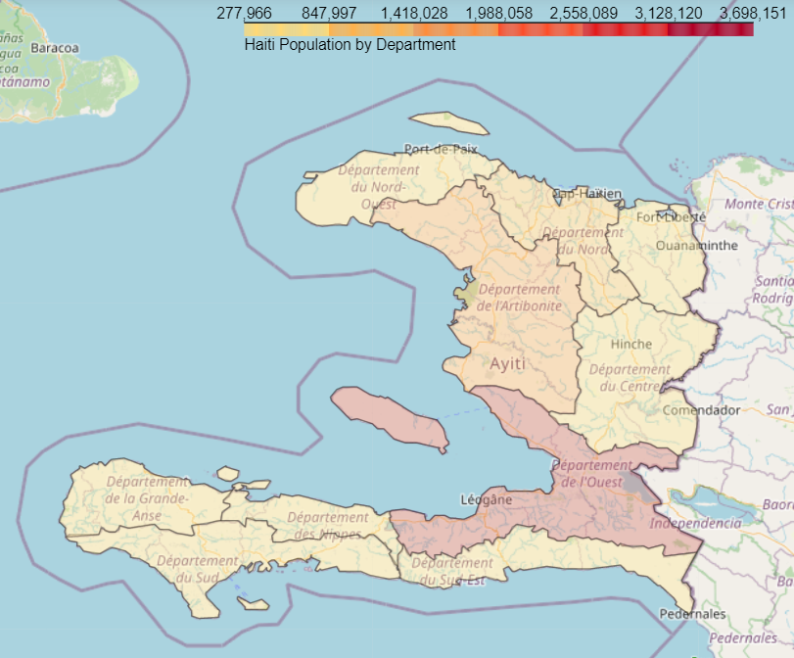
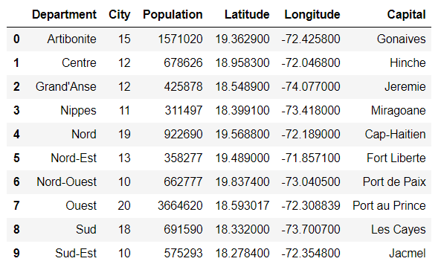
Understanding Haiti geography
List of Departments with City count, coordinates and population.

Slide 5
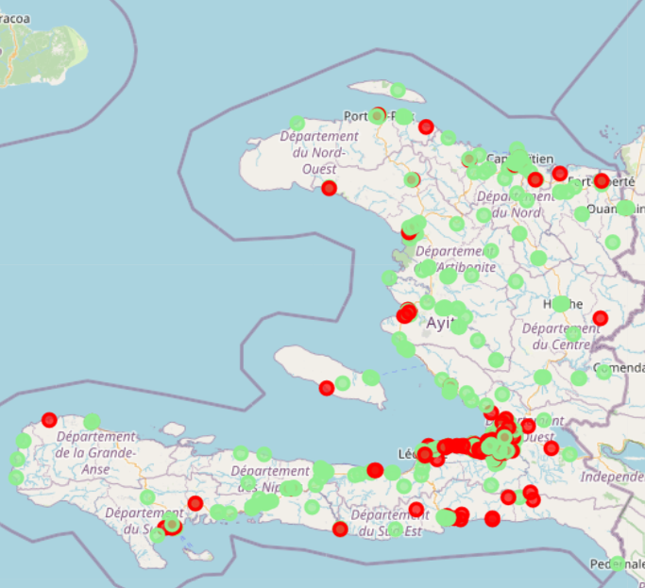
Current money remittance locations view
Map view highlighting locations with and without activity

Slide 6
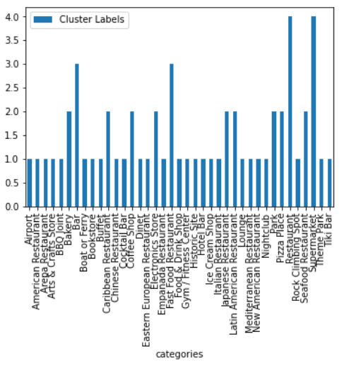
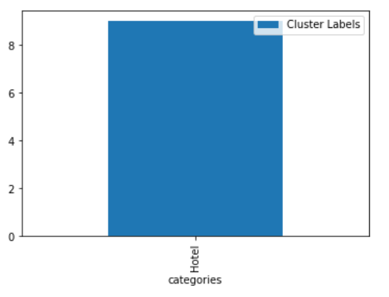
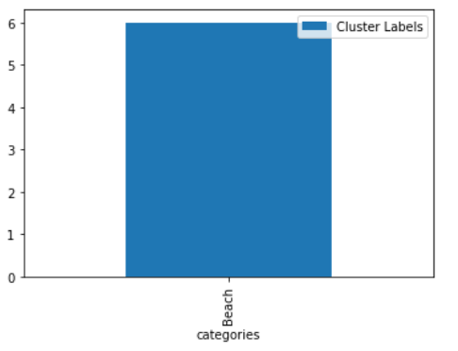
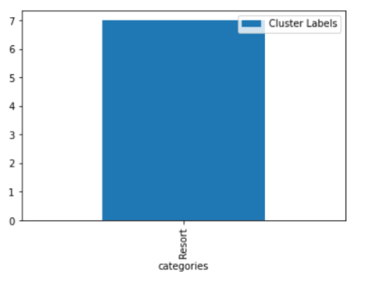
Haiti nearby venues cluster analysis

Slide 7
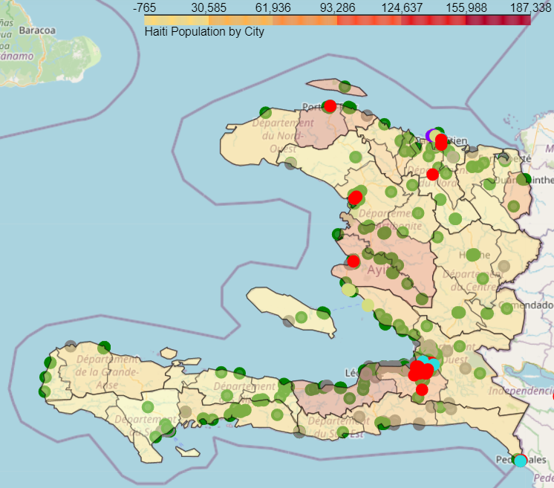
Haiti nearby venues clusters
Clusters identified
Map results view
Restaurants, Supermarkets and other social Venues
Beach
Hotels
Resorts

Slide 8
Nearby venues cluster results by department

Slide 9
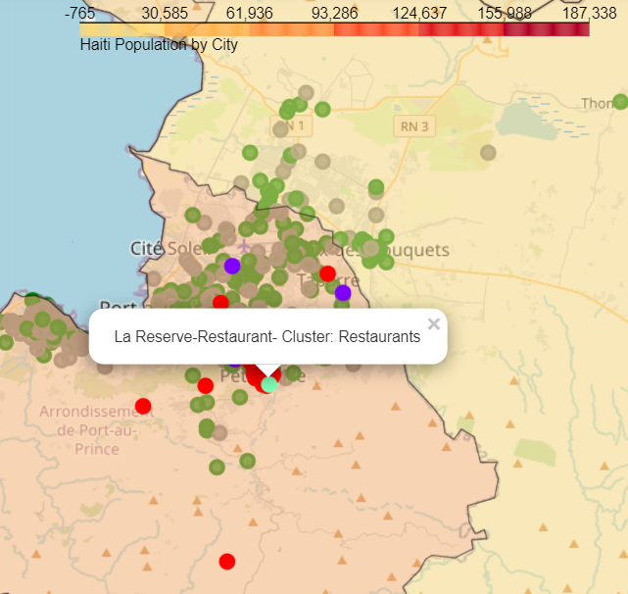
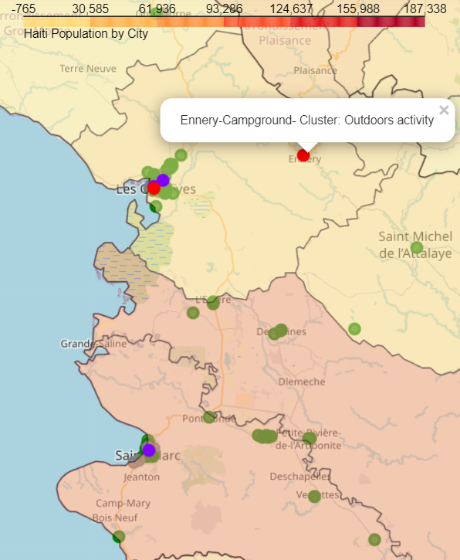
Ouest Department
Artibonite Department
Resorts and Supermarkets
Hotels
Restaurants
Outdoors activity
Restaurants

Slide 10
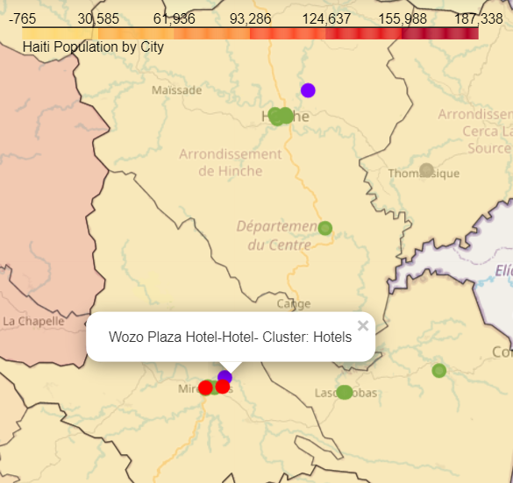
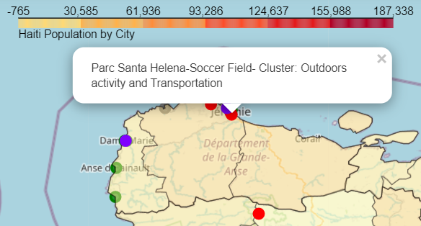
Centre Department
Grand’Anse Department
Outdoors activity
Hotels
Outdoors activity and Transportation
Restaurants

Slide 11
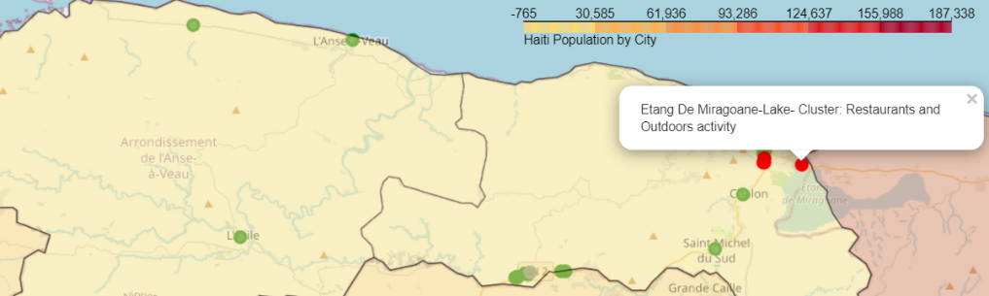
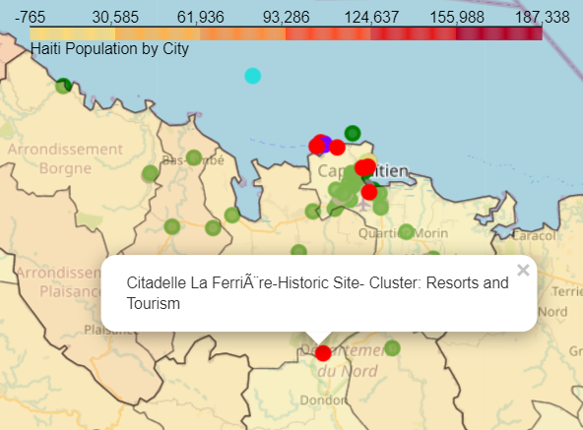
Nippes Department
Nord Department
Outdoors activity
Restaurants
Resorts and Tourism
Beach
Water activity
Hotels

Slide 12
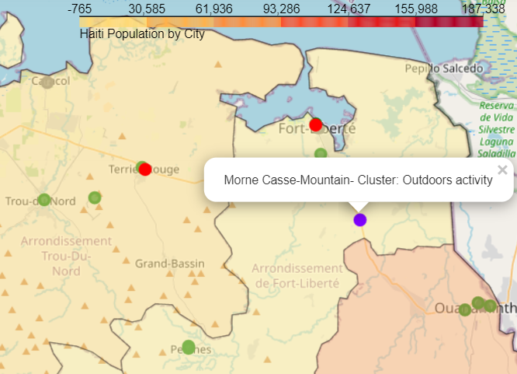
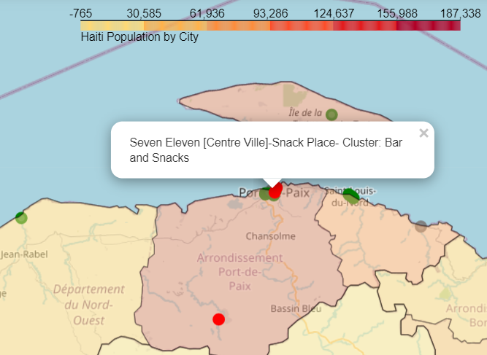
Nord-Est Department
Nord-Ouest Department
Beach and Tourism
Outdoors activity
Bar and Snacks
Restaurants

Slide 13
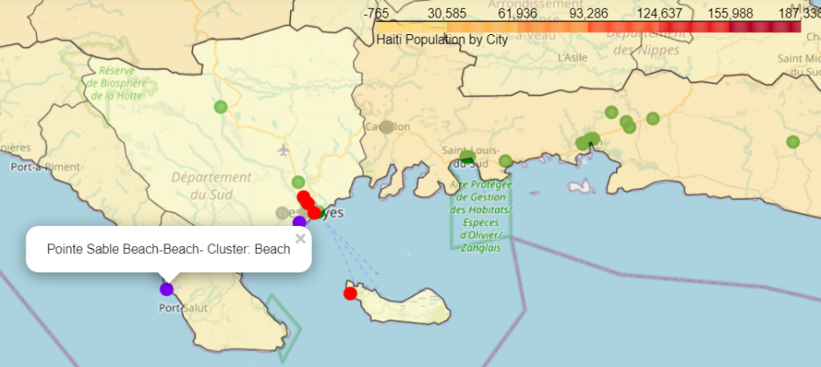
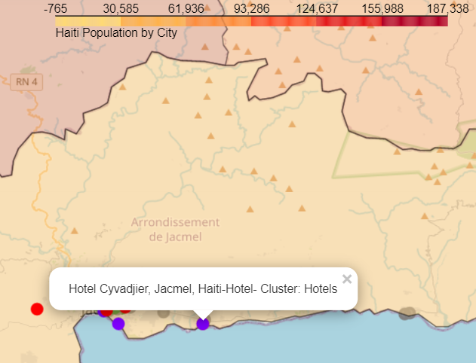
Sud Department
Sud-Est Department
Food venues
Beach
Restaurants and Outdoors activity
Hotels

Slide 14
Results and conclusions
The final map for Haiti and for each Department provides visibility of possible gaps where Money Remittance locations could be a good opportunity for a Money Remittance enterprise and gain for Haitian community.
As additional points, the analysis provided other inputs for the enterprise to review, analyze and optimize their current locations distribution.
There are several opportunities for the stakeholders on different areas:
Data clean-up to ensure coordinates and addresses are accurate.
Current locations very close to other locations which affects activity/productivity. They should review with local team to analyze the cases and better resource usage.
Work with local team to review potential zones in which a location could be enabled to attract more customers or even a new category of customers.

